Slide 1

Toward a Machine Learning Approach to Predict the CO₂ Rating of Fuel-Consuming Vehicles in Canada
Paper ID : 133
Authors: Suborno Deb Bappon, Ashim Dey, Shahriar Mahmud Sabuj, Annesha Das
Department of Computer Science and Engineering,
Chittagong University of Engineering and Technology (CUET)
Presenter : Suborno Deb Bappon
IEEE ICCIT 2022 (Conference ID - 57492), 17-19 Dec. 2022, Cox’s Bazar, Bangladesh

Slide 2
Outline
Introduction
Motivation
Objectives
Related Works
Methodology
Dataset Description
Dataset Accumulation
Experiment
Experimental Results
Error Analysis
Limitations
Future Improvements
Conclusion
References
Notes:
Here is the outline of our presentation

Slide 3
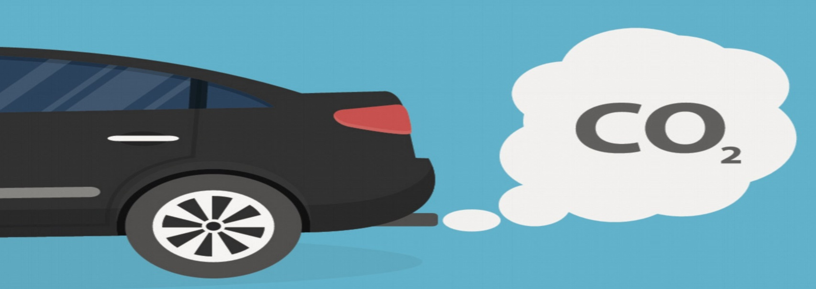
Introduction
Global warming has become a major concern for almost all countries.
Along with other factors, the emission of CO₂ from vehicles in the environment plays a major role in raising the temperature and climate change.
Image Source: https://www.thisismoney.co.uk/money/cars/article-5439951/Car-exhaust-CO2-emissions-rIse-time-2-decades.html

Slide 4
Introduction (cont.)
Global warming occurs when CO₂, as well as other air pollutants builds up a layer in the atmosphere.
Human sources of CO₂ emanations have been growing since the industrial revolution.
Therefore, it becomes very important identify the vehicles with CO₂ emissions beyond the ideal range.

Slide 5
Motivation
Among all human-produced CO₂ sources, the vehicle is the major emitter.
Almost one-fifth of CO₂ emissions in the US are produced by vehicles and trucks, which generate 24 lbs of CO₂ per gallon of fuel.
A typical passenger vehicle emits about 4.6 metric tons of carbon dioxide per year.
According to Climate Action Tracker, by the end of the century, the global temperature will rise by 3.3 Celsius on average.
This work will contribute to the field of identifying and designing low CO₂ emitting vehicles.

Slide 6
Objectives
To Predict CO₂ emission rating from various vehicle sources based on their key features using different Machine Learning techniques.
To identify the influential characteristics of high CO₂ emitting vehicles by analyzing the data.
To assess the overall performance of the applied ML techniques and choose the best technique for the prediction task.

Slide 7
Related Works
Carbon dioxide emission prediction using support vector machine[1] (C. Saleh et al., 2016)
Predict amount of discharge CO₂.
Based on Alcohol Industry.
Used burning coal(kg) and electrical energy(kWh) as input parameter.
Prediction model: CO₂ emission using machine learning.[2] (P. Kadam et al. 2018)
Predict CO₂ emissions.
Used data is based on various industries.
References: [1] C. Saleh, N. R. Dzakiyullah, and J. B. Nugroho, “Carbon dioxide emission prediction using support vector machine,” in IOP Conference Series: Materials Science and Engineering, vol. 114, no. 1. IOP Publishing, 2016, p. 012148.
[2] P. Kadam and S. Vijayumar, “Prediction model: CO₂ emission using machine learning,” in 2018 3rd International Conference for Convergence in Technology (I2CT). IEEE, 2018, pp. 1–3.

Slide 8
Related Works (Cont.)
Modelling of CO emissions from traffic vehicles using artificial neural networks. [3] (O.S. Azeez et al., 2019)
Predict discharge amount of CO from traffic vehicles.
Used hybrid model that combine GIS model and optimized ANN algorithm.
Prediction of vehicle CO₂ emission and its application to eco-routing navigation. [4] (W. Zeng et al., 2016)
Estimated vehicle CO₂ emissions per kilometer.
Used to find an environmentally favorable route that emits the least amount of CO₂.
References: [3] O. S. Azeez, B. Pradhan, H. Z. Shafri, N. Shukla, C.-W. Lee, and H. M. Rizeei, “Modeling of CO emissions from traffic vehicles using artificial neural networks,” Applied Sciences, vol. 9, no. 2, p. 313, 2019.
[4] W. Zeng, T. Miwa, and T. Morikawa, “Prediction of vehicle CO₂ emission and its application to eco-routing navigation,” Transportation Research Part C: Emerging Technologies, vol. 68, pp. 194–214, 2016.

Slide 9
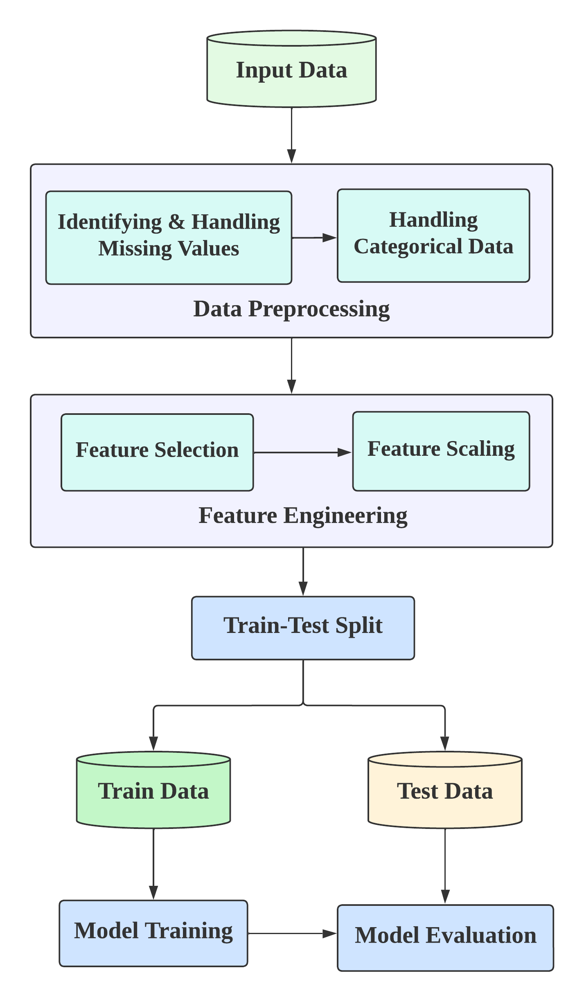
Methodology
Figure 1 : Proposed Methodology

Slide 10
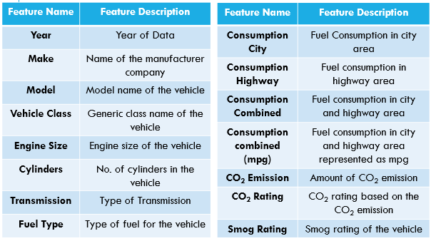
Dataset Description
Table 1 : Dataset Description including all columns.

Slide 11
Data Accumulation
Collected dataset from Open Government Portal of Canada.
It consists of 15 features.
Last five years (2017-2021) of fuel consumption data are considered.
5000 records.

Slide 12
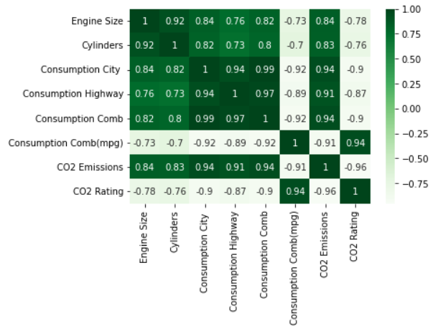
Data Analysis
Correlation Matrix
Figure 2: Correlation Matrix of all Features

Slide 13
Experiment
Table 2 : Dataset splitting.
Phase | Data
Train | 4000
Test | 1000

Slide 14
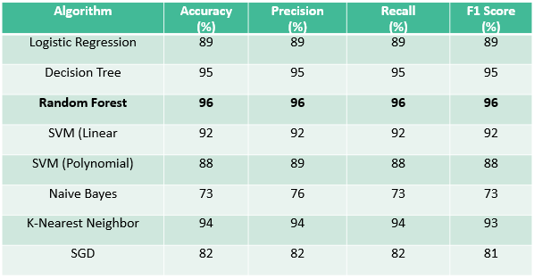
Experimental Result
Table 3 : Performance comparison among ML models.

Slide 15
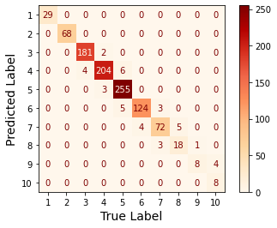
Error Analysis
Confusion Matrix
Figure 3: Confusion Matrix for Random Forest

Slide 16
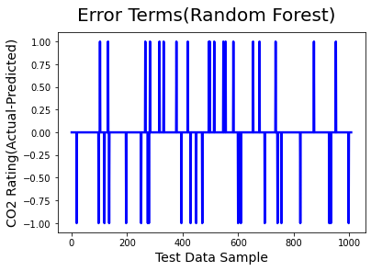
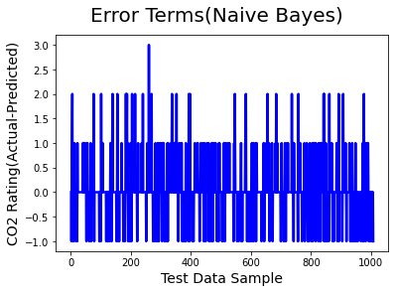
Error Analysis (Cont.)
Figure 4 : Error (Actual-Predicted Data) for Random Forest.
Figure 5 : Error (Actual-Predicted Data) for Naive Bayes.

Slide 17
Limitations
Less variance in the dataset.
Dataset is only based on the regions of Canada.

Slide 18
Future Improvements
Expansion of the dataset.
Collecting data from different regions.
Applying Deep Learning approaches.
Developing a web based application.

Slide 19
Conclusion
One of the major causes of global temperature rising and green house effect is the human-produced CO₂, most of which are generated by vehicles.
A Machine Learning based model using Random Forest technique is developed to predict CO₂ emission ratings from various vehicle sources which generates the highest accuracy of 96%.
We hope that this work will contribute to the field of identifying and designing low CO₂ -emitting vehicles.
By developing and proposing a model for the prediction of CO₂ rating, the research attempted to have an positive impact on build a pollution free world.

Slide 20
References
[1] C. Saleh, N. R. Dzakiyullah, and J. B. Nugroho, “Carbon dioxide emission prediction using support vector machine,” in IOP Conference Series: Materials Science and Engineering, vol. 114, no. 1. IOP Publishing, 2016, p. 012148.
[2] P. Kadam and S. Vijayumar, “Prediction model: CO₂ emission using machine learning,” in 2018 3rd International Conference for Convergence in Technology (I2CT). IEEE, 2018, pp. 1–3.
[3] O. S. Azeez, B. Pradhan, H. Z. Shafri, N. Shukla, C.-W. Lee, and H. M. Rizeei, “Modeling of CO emissions from traffic vehicles using artificial neural networks,” Applied Sciences, vol. 9, no. 2, p. 313, 2019.
[4] W. Zeng, T. Miwa, and T. Morikawa, “Prediction of vehicle CO₂ emission and its application to eco-routing navigation,” Transportation Research Part C: Emerging Technologies, vol. 68, pp. 194–214, 2016.

Slide 21
THANK YOU

